Slide 1
Towards a Systematic Combination of Dimension Reduction and Clustering in Visual Analytics
Authors: John wenskovitch et al.
ieee transactions on visualization and computer graphics 2017

Slide 2
Abstract
Dimension reduction and clustering are common techniques in high-dimensional data analysis.
Recent visualization works begin to incorporate them into same visualization systems.
However, these combinations are often at hoc or disconnected.
This paper will provide an overview of combining dimension reduction and clustering into a visualization system and discuss the design decisions when creating a visualization system.

Slide 3
Outline
Combination of Dimension Reduction and Clustering in visualization system
Clustering
Dimension reduction

Slide 4
1. Dimension reduction and Clustering combinations
It is often very important to consider the order of dimension reduction and clustering algorithms are performed on the data.
The order may generate projections with different semantic meaning.

Slide 5
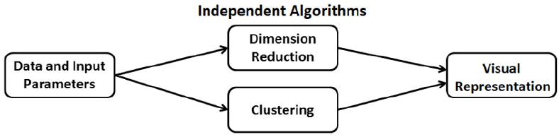
Independent Algorithms

Slide 6
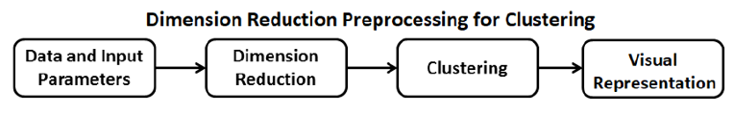
Dimension Reduction Preprocessing for Clustering

Slide 7
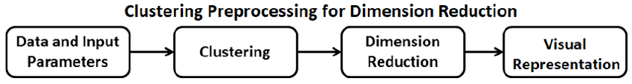
Clustering Preprocessing for Dimension Reduction

Slide 8
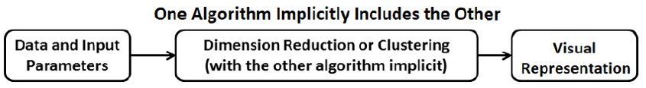
One Algorithm Implicitly Includes the Other

Slide 9
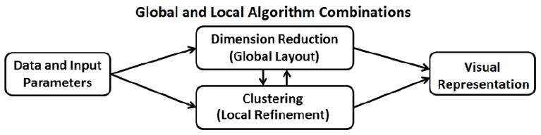
Global and Local Algorithm Combinations

Slide 10
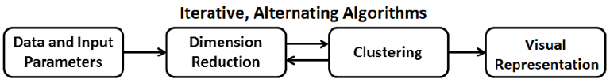
Iterative, Alternating Algorithms

Slide 11
2. Clustering Algorithms
The most common clustering algorithm is k-means.
The k-means algorithm has been extended to support a variety of tasks, including weighted clustering, hierarchical clustering, textual data, and constrained clustering.
The algorithm requires input parameter k for the number of clusters to create, presenting an additional complication in generating the best set of clusters with its heuristic approach.
Several solutions to determine the most appropriate k value are used, such as the elbow method.

Slide 12
Fuzzy C-means Clustering algorithm
It is a fuzzy extension of the k-means algorithm, the centroid of a cluster is now computed as the mean of all observations weighted by their probability of belonging to the cluster.
Fuzzy C-means has found use in the fields of bioinformatics and image analysis.

Slide 13
3. Dimension reduction algorithms
Linear class:
Principal Component Analysis (PCA) Multidimensional Scaling (MDS)
Nonlinear class:
t-SNE
Isomap
Latent Dirichlet Allocation (LDA)

Slide 14
Linear class
Principal Component Analysis (PCA) is perhaps the most frequently- used linear dimension reduction algorithm.
Multidimensional Scaling (MDS) computes pairwise distances between observations in the high-dimensional space and attempts to preserve those distances in a low-dimensional projection.

Slide 15
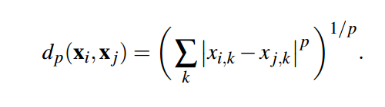
Distance functions
P=1, Manhattan distance
P=2, Euclidean distance

Slide 16
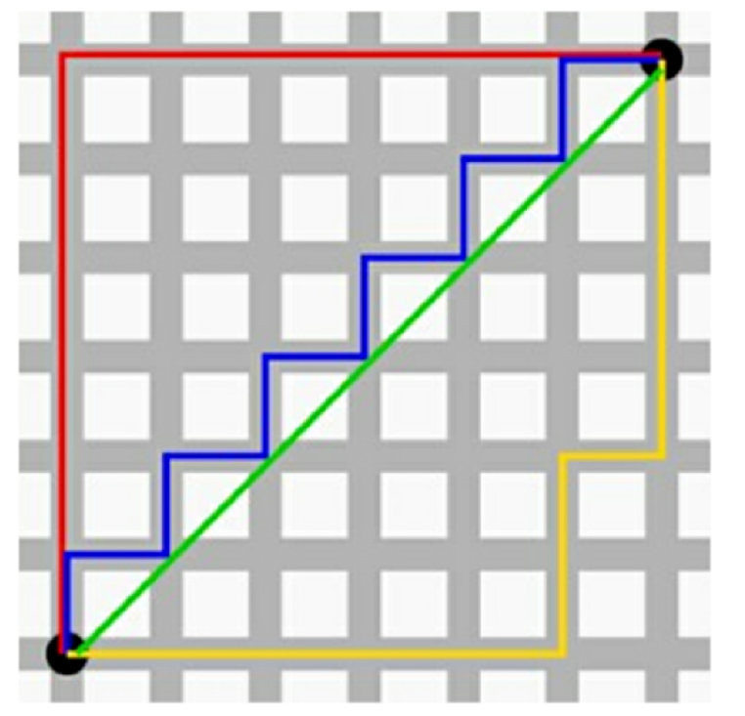
Manhattan distance
B
Green: Euclidean distance
Red: Manhattan distances
Blue and yellow = Red
A

Slide 17
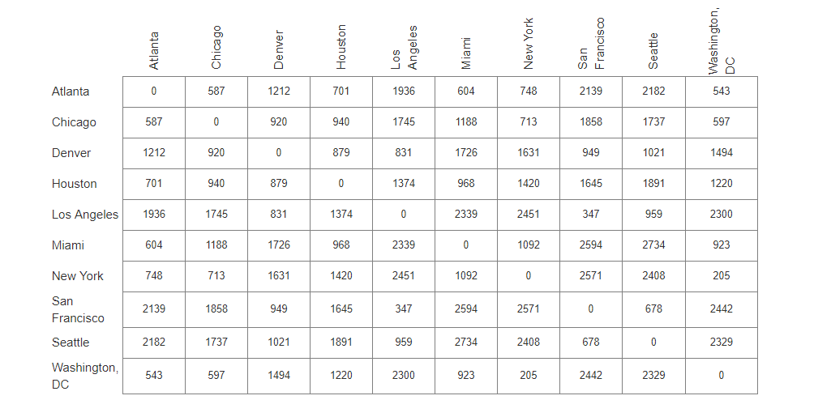
Distances between US cities:

Slide 18
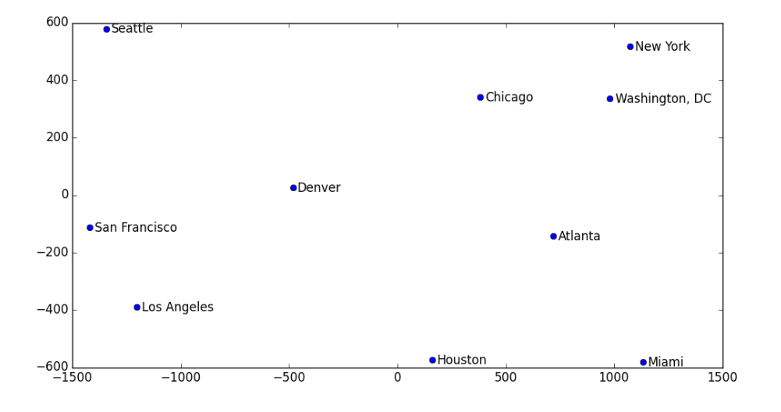
Data visualization using MDS

Slide 19
Nonlinear class
t-SNE converts affinities of data points to probabilities. The affinities in the original space are represented by Gaussian joint probabilities and the affinities in the embedded space are represented by Student’s t-distributions.
This allows t-SNE to be particularly sensitive to local structure and has a few other advantages over existing techniques:
Revealing the structure at many scales on a single map
Revealing data that lie in multiple, different, manifolds or clusters
Reducing the tendency to crowd points together at the center

Slide 20
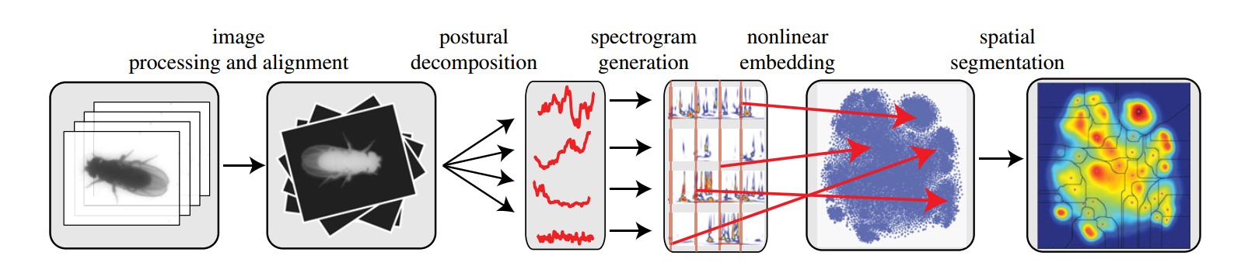
An interesting application of t-SNE
Paper: “Mapping the stereotyped behaviour of freely moving fruit flies” [3] Biobehavioral Science

Slide 21
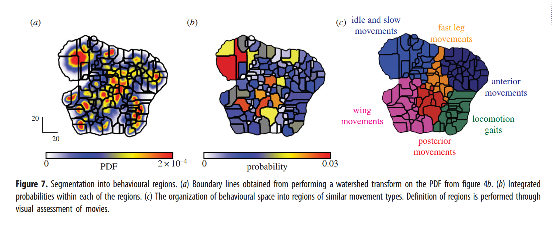
Behavioural regions

Slide 22
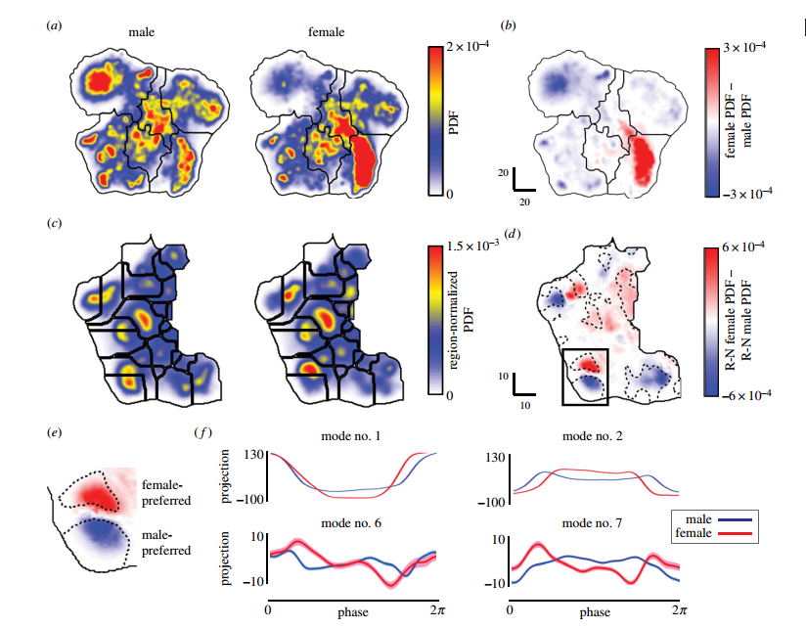
Action of cleaning left wing is different

Slide 23
Visualizing High-Dimensional Space
https://www.youtube.com/watch?v=wvsE8jm1GzE

Slide 24
References
[1] http://www.benfrederickson.com/multidimensional-scaling/
[2] https://en.wiktionary.org/wiki/Manhattan_distance
[3] Berman, Gordon J., et al. "Mapping the stereotyped behaviour of freely moving fruit flies." Journal of The Royal Society Interface 11.99 (2014): 20140672.
[4] Wenskovitch, John, et al. "Towards a Systematic Combination of Dimension Reduction and Clustering in Visual Analytics." IEEE transactions on visualization and computer graphics24.1 (2018): 131-141.

